Slide 1

Optimal Purchase Strategy For
Retail Beer Store
Julius Lee, Pei-Heng Wu

Slide 2

Problem Idea
If we are retail beer sellers, we might need help for selecting beers to sell.
Idea: Create an optimization program that helps us to decide what kind and what amount of beer should we purchase and sell to customers.
This idea is interesting because Madison is one of the best places for beer.

Slide 3

DataSets
Beer_profile_and_ratings.csv from Kaggle. (https://www.kaggle.com/ruthgn/beer-profile-and-ratings-data-set)
Makeup_beer_price.csv.
Since we do not have the beer price dataset, we made up our price data by using Excel random normal distribution function.

Slide 4
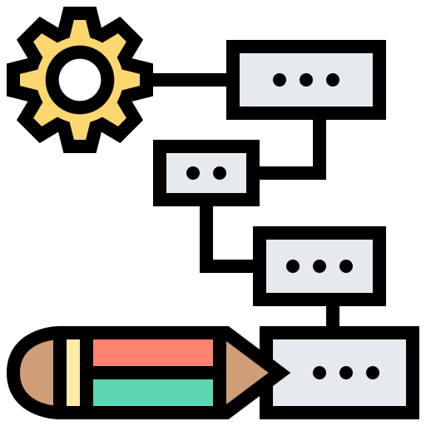
Optimization Model
Decision Variables:
2384 Binary decision variables.
What kind of beer should we purchase? )
2384 Non-negative integer decision variable.
(How many bottles for each kind of beer should we purchase?)
Objective: Minimum the purchase cost.

Slide 5
Optimization Model
Constraints:
Each style (111 styles) of beer need at least one.
The number of reviews of each beer we purchase needs to be larger than 25% of all beer.
Average AVB, Astringency, Body, Alcohol, Bitter, Sweet, Sour, Salty, Fruits, Hoppy, Spices, Malty need to be between 25% and 75% of all beer.
Average review aroma and review taste rate need to be larger than 50% of all beer.

Slide 6
Optimization Model
Constraints:
Each kind of beer can at most import 50 bottles .
If we want to purchase, must purchase more than 5 bottles.
Budget constraint, the total cost must lower than our budget (50000).
The average overall rate needs to be larger than 4 .
We need at least 3000 bottles of beer in our store.

Slide 7
Optimization Model
The tool we used to build our model is Python and Pyomo packages.
We choose to use “glpk” to solve Linear Problem and setting the “mipgap” equals 2%.
The reason we use Python
We have a large dataset.
We could use functions (i.e. For Loop) to help us build models more easily.

Slide 8

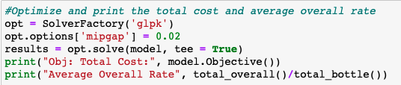
Optimization Model
Objective code:
Applied Solver:

Slide 9
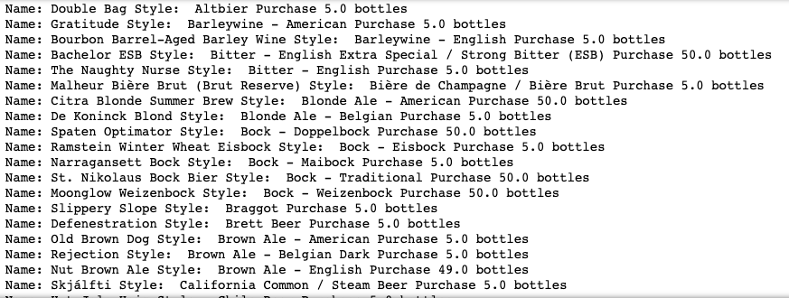
Optimization Model
Result of our optimal model:

Slide 10

Challenges
Brainstorming our model objective and constraints
Preparing data is challenging:
Transforming data into the right format.
Creating a new csv file “ makeup_beer_price.csv “

Slide 11
Challenges
One of the constraints in our model requires if we decide to import a beer, we need to import a minimum of 5 bottles. However, since our decision variables (how many bottles )are not binary, so we need to create another set of decision variables that are binary to help us implement this constraint.

Slide 12

Hypothetical Client(s)
Retail beer sellers
Restaurants owner
Bar owner

Slide 13

Benefits to Hypothetical Clients
Assists hypothetical clients in selecting beers and minimize their costs.
Ensure clients purchase wine with high rating.
Ensure the beer quality meets the client’s requirement.

Slide 14

Limitations of Project
If we want to find the best solution or set the optimality gap to 1%, it would take a very long time to complete calculation.
If we try to change our objective to maximizing the average rating of all the beers we import, we can’t solve it with linear programming.

Slide 15

Next Step If We Have More Time
If we want to find the best solution or set the optimality gap to 1%, it would take a very long time to complete calculation.
If we try to change our objective to maximizing the average rating of all the beers we import, we can’t solve it with linear programming.
Try to find the real price of each type of beer.
Try to explore other practical constraints.

Slide 16

The Content of Coding Scripts
How we import and transform data into the format we needed.
The python code to build our model.
The output of running our model with data we obtain from Kaggle.

Slide 17

Contribution
All the works are equally divided.

Slide 18

THE END
Thank you

